Slide 1
Apache Spark

Slide 2

INTRODUCTION
BIG DATA ANALYTICS
The process of gaining useful business insights, market trends, customer preferences and to uncover hidden patterns by examining huge data sets
TWO TYPES:
Batch Processing
Real time

Slide 3
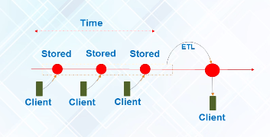
BATCH PROCESSING
Data is processed in batch.
Data collected over a particular period of time is processed
We derive information from historical data

Slide 4
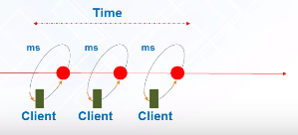
REAL TIME PROCESSING
Data is processed as and when it arrives
Immediate results as and when data arrives

Slide 5
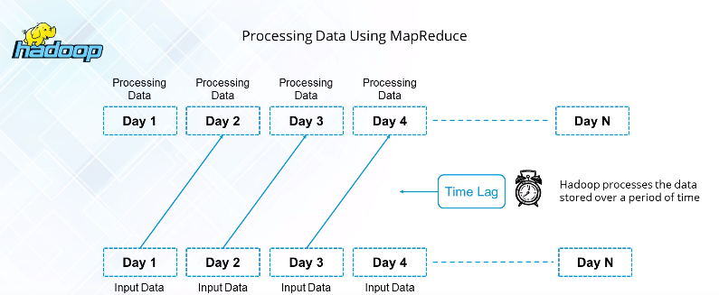
HADOOP – MAP REDUCE
Batch Processing not meant for real time processing

Slide 6
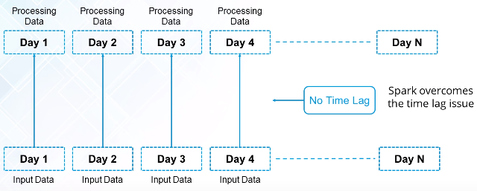
SPARK
Immediate Processing of data, no time lag
Can also be used to do batch processing

Slide 7


Slide 8
Problem with Map Reduce and Reason for slower processing
Mapper
(O1)
Reducer
(O4)
(W,1)
(L,1)
(M,1)
(W,1)
(L,1)
…
Sort and Shuffle
(O3)
Windows, Linux, MAC
Windows, Linux
Windows, Linux, MAC
Windows, Linux, MAC
Windows, Linux, MAC
Windows, Linux, MAC
Windows, Linux, MAC
Windows, Linux, MAC
Windows, Linux, MAC
Windows, Linux, MAC
Windows, Linux, MAC
Windows, Linux, MAC
MAC
256 MB
(L,1,1,…)
(M,1,1,1…)
(W,1,1,1,…)
….
(W,80)
..
..
B1
(W,1)
(L,1)
(M,1)
(W,1)
….
(O2)
Master / Name Node
Memory2
Memory1
O2
O3
B2
O1
O1
B1
B2
Slave 1 /Data Node
Slave 2

Slide 9
What is Spark?
Open Source cluster-computing framework for real time data processing
Provides fault tolerance and parallelism
Built on top of Hadoop Map Reduce to extend its capacity
Can be programmed in Python, Scala, R, Java
It is 100X times faster than Hadoop because it uses DAG and Lazy Evaluation

Slide 10
RDD Resilient Distributed Dataset
RDD number= sc.textFile(“f.txt”)
RDD filter1=number.map(“logic to find numbers <10”)
filter1.collect()
Transformation
1,2,4,56,78,34,….
…..
112,3,4,1134,….
….
1,2,3,4,12,134……
…..
B1
Action
1,2,4 (B4)
f.txt
B2
Master
3,4 (B5)
sc
Number RDD
Number
(B1,B2,B3)
B3
1,2,3,4 (B6)
B3
DAG
(Directed Acyclic Graph)
B1
B2
B3
f.txt (384 MB)
B1
B2
Slave2
Slave1
Slave2

Slide 11
RDD Resilient Distributed Dataset
RDD number= sc.textfile(“f.txt”)
RDD filter1=number.map(“logic to find numbers <10”)
filter1.collect()
Transformations
1,2,4,56,78,34,….
…..
112,3,4,1134,….
….
1,2,3,4,12,134……
…..
B1
Action
1,2,4 (B4)
f.txt
B2
Master
3,4 (B5)
sc
number
B3
1,2,3,4 (B6)
B3
filter1
B1
B2
B3
B6
f.txt (384 MB)
B4
B1
B5
B2
Slave1
Slave3
DAG
(Directed Acyclic Graph)
Slave2

Slide 12
RDD number= sc.textfile(“f.txt”)
RDD filter1=number.map(“logic to find numbers <10”)
filter1.collect()
Transformations
Action
f.txt
number
LAZY EVALUATION
filter1
Collect
DAG

Slide 13
Fault Tolerance in Spark
RDD number= sc.textfile(“f.txt”)
RDD filter1=number.map(“logic to find numbers <10”)
filter1.collect()
Transformations
1,2,4,56,78,34,….
…..
112,3,4,1134,….
….
1,2,3,4,12,134……
…..
B1
Action
1,2,4 (B4)
f.txt
B2
Master
3,4 (B5)
sc
Slave4
Number
(B1,B2,B3)
B1
B3
1,2,3,4 (B6)
Filter1
(B4,B5,B6)
B3
B1
B2
B3,B2
f.txt (384 MB)
B1,B3
B2
Slave3
Collect
Slave1
Slave2
Replication factor=2
DAG

Slide 14
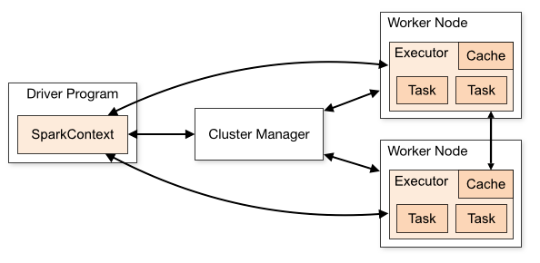
SPARK CLUSTER MANAGEMENT
Spark Context (SC) is the driver program and is the entry point for the Spark Application
SC talks to the cluster manager allocate resources
The cluster manager allocates the resource and starts the executor on the resource
The SC then directly communicates to the executor to execute the tasks (Application Logic)

Slide 15

DEMO

Slide 16
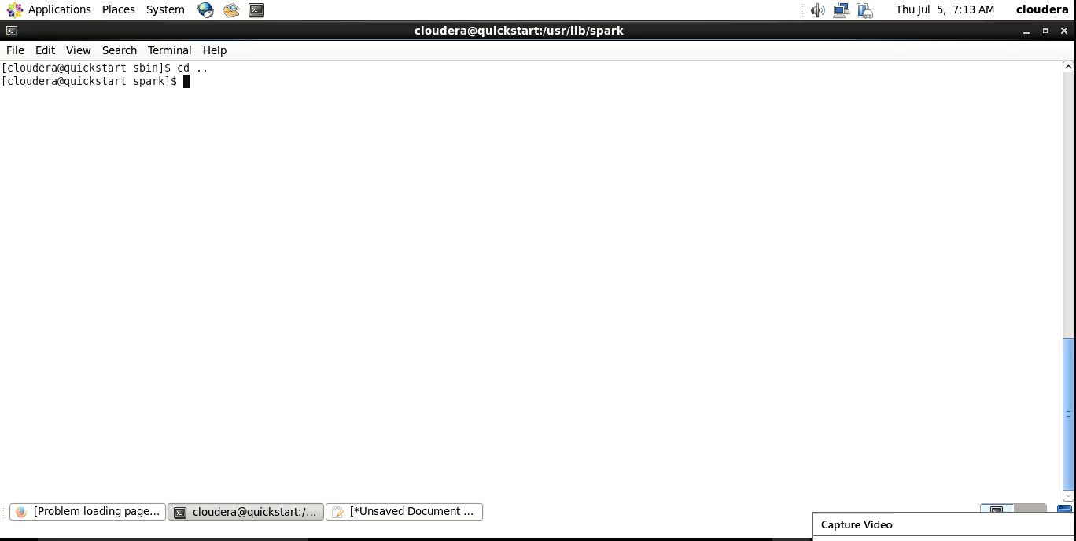

Slide 17
How Spark solves it
Spark makes computations in-memory the number of disk IO is reduced drastically, this increases the speed of computation
1
Spark achieves this using the RDDs (Resilient Distributed Dataset) and Lazy Evaluation
2
Though the computation takes place in-memory(RAM) it is fault tolerant, the data recovery in spark is easier because spark maintains a DAG (Direct Acyclic Graph) for its re-computation
3

Slide 18
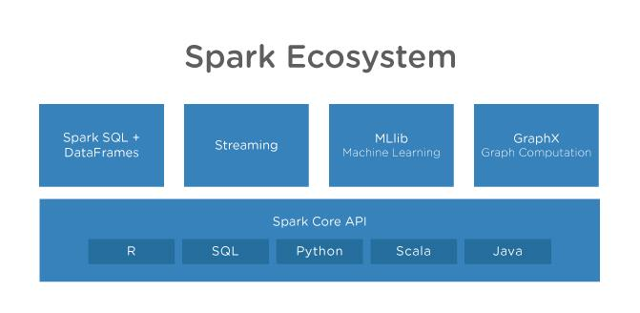

Slide 19
ADVANTAGES OF SPARK
It is 100x times faster than Hadoop map reduce
1
Can ingest data from multiple sources like AWS S3, HDFS, Azure, local filesystem etc
2
Can perform streaming, batch processing, machine learning in the same cluster
3
It has an in-built interactive mode (REPL- Read, Evaluate, Print, Loop)
4

Slide 20

USE CASES IN CONTACT CENTER
Speech Analytics
IVR Analytics
Cross Channel Analytics
Predictive Analytics
Performance Analysis

Slide 21
THANK YOU

